Slide 1

Cryptography
Dr. Tran The Son
Notes:
Lecture slides prepared for “Cryptography and Network Security”, 6/e, by William Stallings, Chapter 4 – “Basic Concepts in Number Theory and Finite Fields”.

Slide 2
Chapter 5
Finite Fields
Notes:
The Advanced Encryption Standard (AES) was published by the National Institute
of Standards and Technology (NIST) in 2001. AES is a symmetric block cipher that
is intended to replace DES as the approved standard for a wide range of applications.
Compared to public-key ciphers such as RSA, the structure of AES and most symmetric
ciphers is quite complex and cannot be explained as easily as many other cryptographic
algorithms. Accordingly, the reader may wish to begin with a simplified version
of AES, which is described in Appendix 5B. This version allows the reader to perform
encryption and decryption by hand and gain a good understanding of the working of
the algorithm details. Classroom experience indicates that a study of this simplified
version enhances understanding of AES. One possible approach is to read the chapter
first, then carefully read Appendix 5B, and then re-read the main body of the chapter.

Slide 3
Chapter 5: Outline
Groups
Rings
Fields
Finite Fields of the Form GF(p)
Polynominal Arithmetic
Finite Fields of the Form GF(2^{n})

Slide 4
Groups
A set of elements with a binary operation denoted by • that associates to each ordered pair (a,b) of elements in G an element (a • b ) in G , such that the following axioms are obeyed:
  (A1) Closure:
    If a and b belong to G, then a • b is also in G
  (A2) Associative:
    a • (b • c) = (a • b) • c for all a, b, c in G
  (A3) Identity element:
    There is an element e in G such that a • e = e • a = a for all a in G
  (A4) Inverse element:
    For each a in G, there is an element a in G such that a•a = a • a = e
  (A5) Commutative:
    a • b = b • a for all a, b in G
Abel
Group
Group
Notes:
Groups, rings, and fields are the fundamental elements of a branch of mathematics
known as abstract algebra, or modern algebra. In abstract algebra, we are concerned
with sets on whose elements we can operate algebraically; that is, we can combine
two elements of the set, perhaps in several ways, to obtain a third element of the set.
These operations are subject to specific rules, which define the nature of the set. By
convention, the notation for the two principal classes of operations
on set elements is usually the same as the notation for addition and multiplication on ordinary numbers.
However, it is important to note that, in abstract algebra, we are not limited to
ordinary arithmetical operations. All this should become clear as we proceed.
A group G , sometimes denoted by {G , * }, is a set of elements with a binary operation
denoted by * that associates to each ordered pair (a, b ) of elements in G an element
(a ~ b ) in G , such that the following axioms are obeyed:
(A1) Closure:
If a and b belong to G, then a * b is also in G
(A2) Associative:
a * (b * c) = (a * b) * c for all a, b, c in G
(A3) Identity element:
There is an element e in G such that a * e = e * a = a for all a in G
(A4) Inverse element:
For each a in G, there is an element a in G such that a*a = a * a = e
(A5) Commutative:
a * b = b * a for all a, b in G

Slide 5
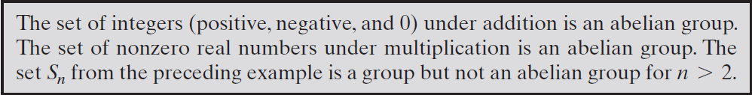
Abel Group
A group is said to be Abelian if it satisfies the following additional condition:
  (A5) Commutative: a • b = b • a for all a, b in G.

Slide 6
Cyclic Group
Exponentiation is defined within a group as a repeated application of the group operator, so that a³ = a•a•a
We define a⁰ = e as the identity element, and a^{-n} = (a’)^{n} , where a’ is the inverse element of a within the group
A group G is cyclic if every element of G is a power a^{k} (k is an integer) of a fixed element
  The element a is said to generate the group G or to be a generator of G
  A cyclic group is always abelian and may be finite or infinite
Notes:
Define exponentiation in a group as the repeated use of the group operator. Note that we are most familiar with it being applied to multiplication, but it is more general than that. If the repeated use of the operator on some value a in the group results in every possible value being created, then the group is said to be cyclic, and a is a generator of (or generates) the group G.

Slide 7
Rings
A ring R , sometimes denoted by {R , + , * }, is a set of elements with two binary operations, called addition and multiplication, such that for all a , b , c in R the following axioms are obeyed:
(A1–A5)
  R is an Abelian group with respect to addition; that is, R satisfies axioms A1 through A5. For the case of an additive group, we denote the identity element as 0 and the inverse of a as –a
  (M1) Closure under multiplication:
  If a and b belong to R , then ab is also in R
(M2) Associativity of multiplication:
a (bc ) = (ab)c for all a , b , c in R
(M3) Distributive laws:
a (b + c ) = ab + ac for all a , b , c in R
  (a + b )c = ac + bc for all a , b , c in R
In essence, a ring is a set in which we can do addition, subtraction [a - b = a + (-b )], and multiplication without leaving the set
Notes:
A ring R , sometimes denoted by {R , + , * }, is a set of elements with two binary operations, called addition and multiplication, such that for all a , b , c in R the following axioms are obeyed:
(A1–A5)
R is an abelian group with respect to addition; that is, R satisfies axioms A1 through A5. For the case of an additive group, we denote the identity element as 0 and the inverse of a as –a
(M1) Closure under multiplication:
If a and b belong to R , then ab is also in R
(M2) Associativity of multiplication:
a (bc ) = (ab)c for all a , b , c in R
(M3) Distributive laws:
a (b + c ) = ab + ac for all a , b , c in R
(a + b )c = ac + bc for all a , b , c in R
In essence, a ring is a set in which we can do addition, subtraction [a - b = a + (-b )], and multiplication without leaving the set

Slide 8
Rings (cont.)
A ring is said to be commutative if it satisfies the following additional condition:
(M4) Commutativity of multiplication:
ab = ba for all a, b in R
An integral domain is a commutative ring that obeys the following axioms.
(M5) Multiplicative identity:
There is an element 1 in R such that a 1 = 1a = a for all a in R
(M6) No zero divisors:
If a , b in R and ab = 0, then either a = 0 or b = 0
Commutative
ring
Integral
domain
Notes:
A ring is said to be commutative if it satisfies the following additional condition:
(M4) Commutativity of multiplication:
ab = ba for all a, b in R
An integral domain is a commutative ring that obeys the following axioms.
(M5) Multiplicative identity:
There is an element 1 in R such that a 1 = 1a = a for all a in R
(M6) No zero divisors:
If a , b in R and ab = 0, then either a = 0 or b = 0

Slide 9
Fields
A field F , sometimes denoted by {F, +,* }, is a set of elements with two binary operations, called addition and multiplication, such that for all a, b, c in F the following axioms are obeyed:
(A1–M6)
F is an integral domain; that is, F satisfies axioms A1 through A5 and M1
through M6
(M7) Multiplicative inverse:
For each a in F, except 0, there is an element a⁻¹ in F such that aa⁻¹ = (a⁻¹ )a = 1
In essence, a field is a set in which we can do addition, subtraction, multiplication, and division without leaving the set. Division is defined with the following rule: a /b = a (b⁻¹ )
Notes:
A field F , sometimes denoted by {F , + , * }, is a set of elements with two binary operations,
called addition and multiplication , such that for all a , b , c in F the following
axioms are obeyed.
(A1–M6) F is an integral domain; that is, F satisfies axioms A1 through A5 and
M1 through M6.
(M7) Multiplicative inverse: For each a in F , except 0, there is an element
a⁻¹ in F such that aa⁻¹ = (a⁻¹ )a = 1.
In essence, a field is a set in which we can do addition, subtraction, multiplication,
and division without leaving the set. Division is defined with the following rule:a /b = a (b⁻¹ ).

Slide 10
Fields
A field F, denoted by {F, +}, is a set of elements with two binary operations, called addition and multiplication, such that the following conditions hold
  F forms an abelian group with respect to addition.
  The non-zero elements of F form an abelian group with respect to multiplication.
  The distributive law holds. That is, for all a, b, c in F,
    a(b + c) = ab + ac.
    (a + b)c = ac + bc

Slide 11
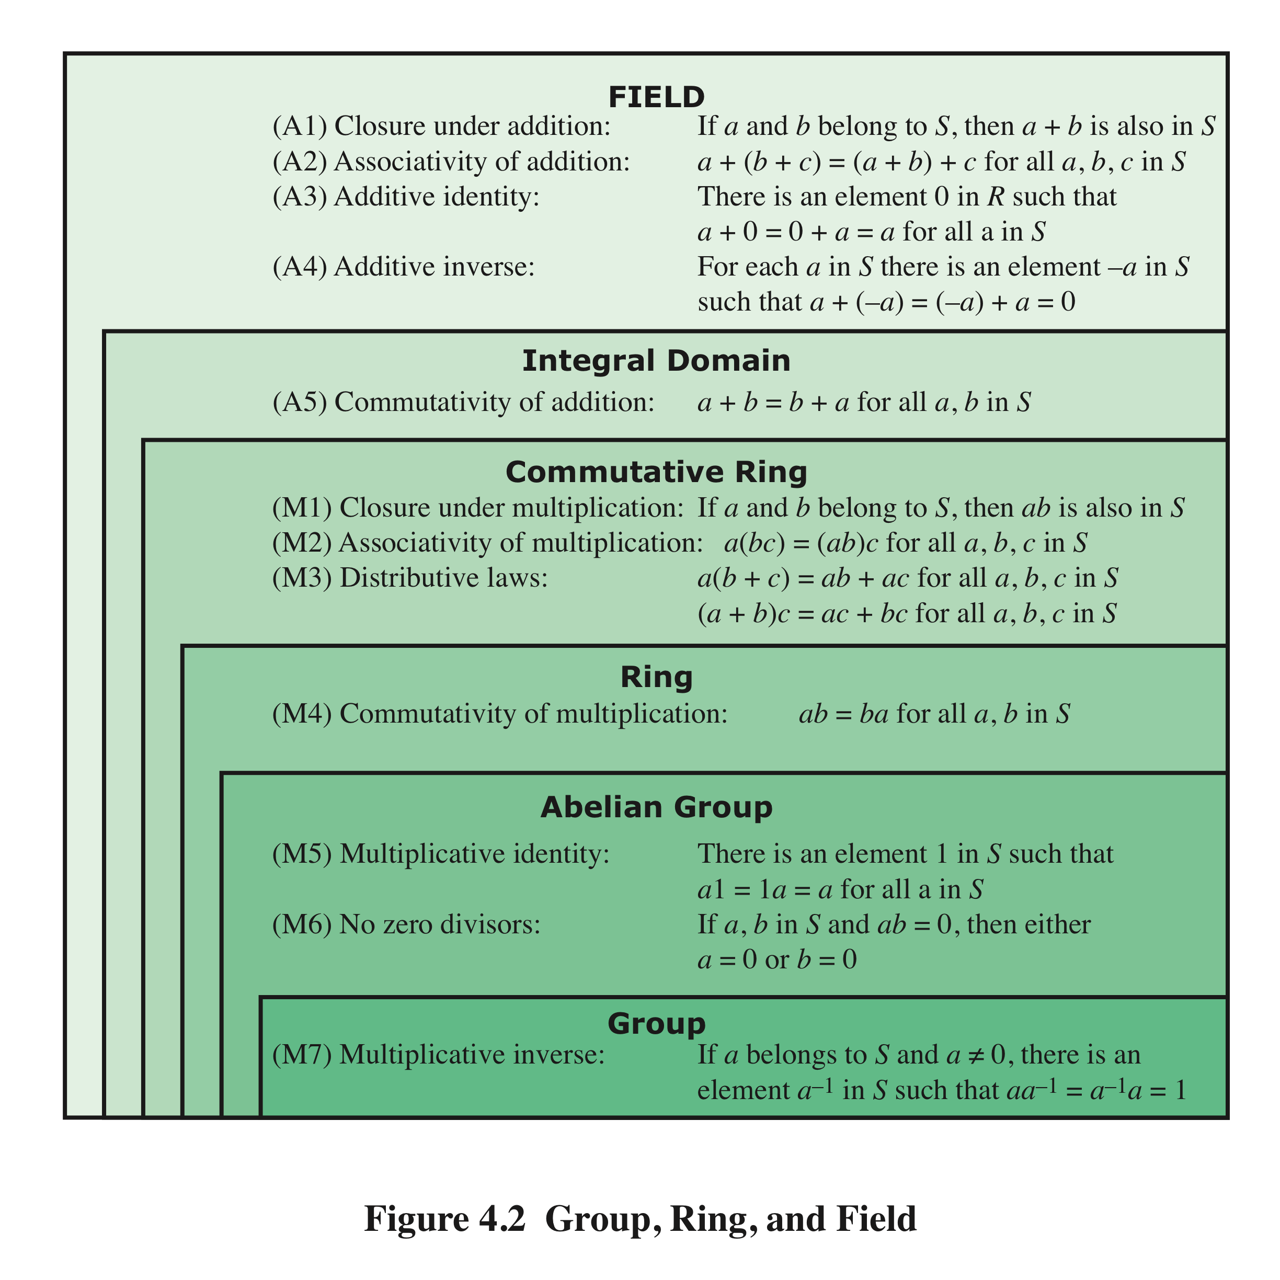
Group, Ring, and Field
Notes:
Figure 4.2 summarizes the axioms that define groups, rings, and fields.

Slide 12
Ví dụ
Trường số nguyên theo mod p, với p là số nguyên tố
{0,1, 2, ….., p-1} mod p
Kiểm tra các tính chất của trường ???????
  A1 – A5: tính chất của group
  M1 – M6: tính chất của ring
  M7: tính chất của trường

Slide 13
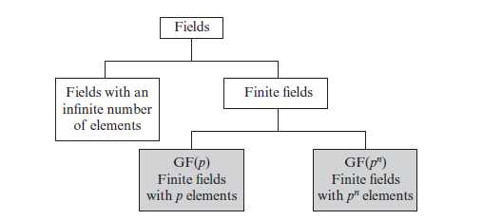
Finite Fields
Infinite fields are not of particular interest in the context of cryptography.
A finite field is a set on which the operations of multiplication, addition, subtraction and division are defined and satisfy certain basic rules.
  E.g. a finite field of the integers mod p when p is a prime number.

Slide 14
Finite Fields of the Form GF(p)
Finite fields play a crucial role in many cryptographic algorithms
For a given prime, p, we define the finite field of order p, GF(p), as the set Z_{p} of integers {0, 1, … , p - 1} together with the arithmetic operations modulo p.
It can be shown that the order of a finite field must be a power of a prime p^{n}, where n is a positive integer
  The only positive integers that are divisors of p are p and 1
The finite field of order p^{n} is generally written GF(p^{n} )
  GF stands for Galois field, in honor of the mathematician who first studied finite fields
Notes:
In Section 4.4, we defined a field as a set that obeys all of the axioms of Figure 4.2
and gave some examples of infinite fields. Infinite fields are not of particular interest
in the context of cryptography. However, finite fields play a crucial role in many
cryptographic algorithms. It can be shown that the order of a finite field (number of
elements in the field) must be a power of a prime p^{n} , where n is a positive integer.
We discuss prime numbers in detail in Chapter 8. Here, we need only say that a
prime number is an integer whose only positive integer factors are itself and 1. That
is, the only positive integers that are divisors of p are p and 1.
The finite field of order p^{n} is generally written GF(p^{n}); GF stands for Galois
field, in honor of the mathematician who first studied finite fields. Two special cases
are of interest for our purposes. For n = 1, we have the finite field GF(p); this finite
field has a different structure than that for finite fields with n > 1 and is studied in
this section. In Section 4.7, we look at finite fields of the form GF(2^{n}).

Slide 15
In this section, we have shown how to construct a finite field of order p, where p is prime.
GF(p) is defined with the following properties:
1. GF(p) consists of p elements
2. The binary operations + and * are defined over the set. The operations of addition, subtraction, multiplication, and division can be performed without leaving the set. Each element of the set other than 0 has a multiplicative inverse
We have shown that the elements of GF(p) are the integers {0, 1, . . . , p – 1} and that the arithmetic operations are addition and multiplication mod p
Notes:
In this section, we have shown how to construct a finite field of order p, where p is prime.
GF(p) is defined with the following properties:
GF(p) consists of p elements
2. The binary operations + and * are defined over the set. The operations of addition, subtraction, multiplication, and division can be performed without leaving the set. Each element of the set other than 0 has a multiplicative inverse
We have shown that the elements of GF(p) are the integers {0, 1, . . . , p – 1} and that the arithmetic operations are addition and multiplication mod p

Slide 16
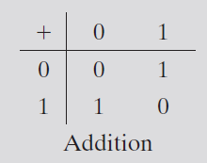
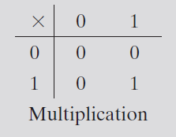
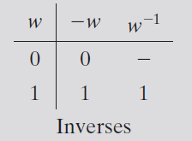
Arithmetic in GF(2)
In this case, addition is equivalent to the exclusive-OR (XOR) operation, and
multiplication is equivalent to the logical AND operation.

Slide 17
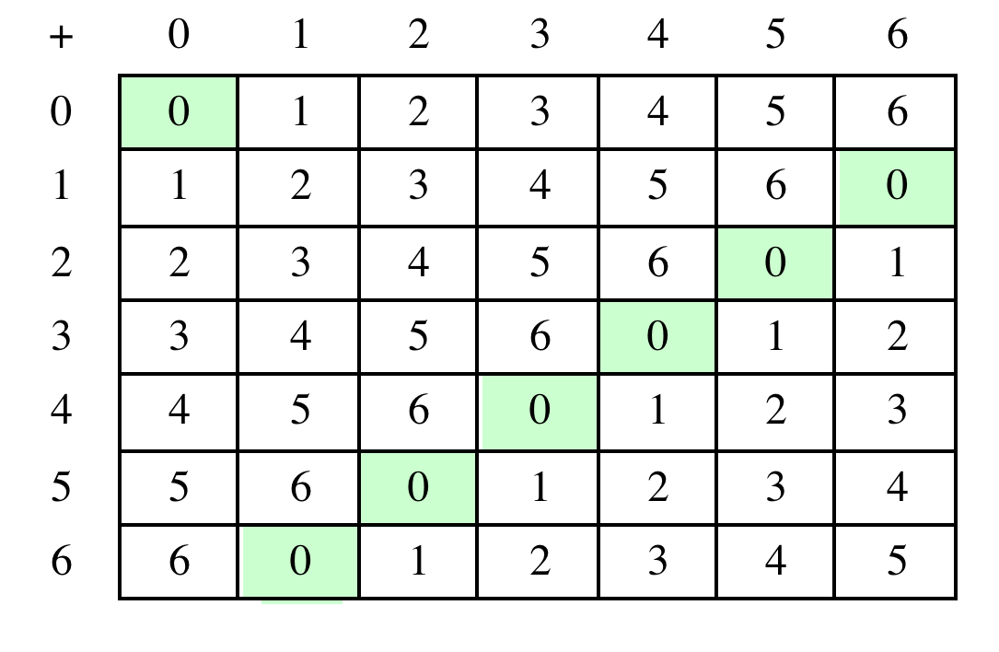
Table 4.5(a) Arithmetic in GF(7)
(a) Addition modulo 7
Notes:
Table 4.5 shows arithmetic operations in GF(7). This is a field of order 7 using
modular arithmetic modulo 7. As can be seen, it satisfies all of the properties required
of a field (Figure 4.2). Compare this table with Table 4.2. In the latter case,
we see that the set Z₈ , using modular arithmetic modulo 8, is not a field. Later in
this chapter, we show how to define addition and multiplication operations on Z₈
in such a way as to form a finite field.

Slide 18
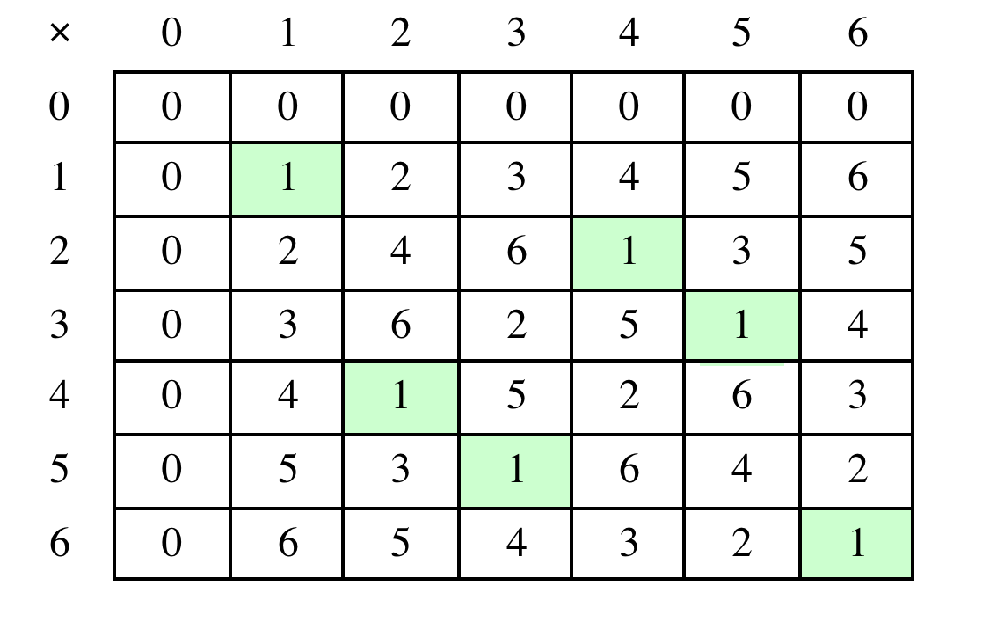
Table 4.5(b) Arithmetic in GF(7)
(b) Multiplication modulo 7
Notes:
Table 4.5 shows arithmetic operations in GF(7).

Slide 19
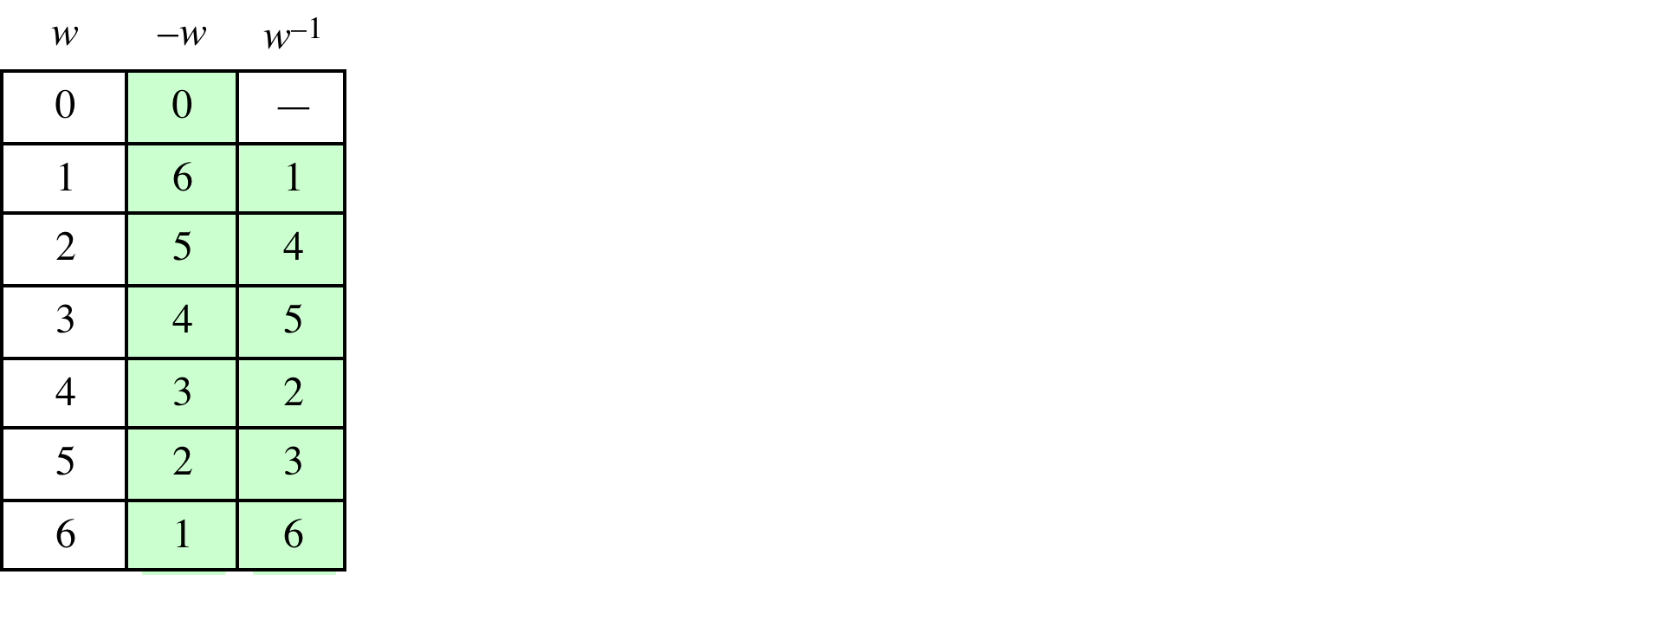
Table 4.5(c)
Arithmetic in GF(7)
(c) Additive and multiplicative inverses modulo 7
Notes:
Table 4.5 shows arithmetic operations in GF(7).

Slide 20
Excercise
Exercise 5.4
  Develop a set of tables similar to Table 4.5 for GF(5).

Slide 21
Finding the Multiplicative Inverse in GF(p)
If a and b are relatively prime, then b has a multiplicative inverse modulo a. That is, if gcd(a, b) = 1, then b has a multiplicative inverse modulo a.
ax + by = d = gcd(a, b) = 1
(ax + by) mod a = 1 mod a
[(ax mod a) + (by mod a)] mod a = 1 mod a
0 + by mod a = 1
Example:
Consider a = 1759 and b = 550.
What is b⁻¹ ?

Slide 22
Summary: Finite Fields of GF(p)
1. GF(p) consists of p elements.
2. The binary operations + and * are defined over the set. The operations of addition, subtraction, multiplication, and division can be performed without leaving the set. Each element of the set other than 0 has a multiplicative inverse, and division is performed by multiplication by the multiplicative inverse.
the elements of GF(p) are the integers {0, 1, c, p - 1} and that the arithmetic operations are addition and multiplication mod p. (p is prime number)

Slide 23
Polynomial Arithmetic
We can distinguish three classes of polynomial arithmetic:
• Ordinary polynomial arithmetic, using the basic rules of algebra
• Polynomial arithmetic in which the arithmetic on the coefficients is performed modulo p; that is, the coefficients are in GF(p)
• Polynomial arithmetic in which the coefficients are in GF(p), and the polynomials are defined modulo a polynomial m (x ) whose highest power is some integer n
Notes:
Before continuing our discussion of finite fields, we need to introduce the interesting
subject of polynomial arithmetic. We are concerned with polynomials in a single
variable x , and we can distinguish three classes of polynomial arithmetic.
• Ordinary polynomial arithmetic, using the basic rules of algebra.
• Polynomial arithmetic in which the arithmetic on the coefficients is performed
modulo p ; that is, the coefficients are in GF(p ).
• Polynomial arithmetic in which the coefficients are in GF(p ), and the polynomials
are defined modulo a polynomial m (x ) whose highest power is some integer n .

Slide 24
Ordinary Polynomial Arithmetic Example
As an example:
let f(x) = x³ + x² + 2 and g(x) = x² - x + 1, where S is the set of integers
Then:
f(x) + g(x) = x³ + 2x² - x + 3
f(x) - g(x) = x³ + x + 1
f(x) * g(x) = x⁵ + 3x² - 2x + 2
Figures 4.3a through 4.3c show the manual calculations
Notes:
Polynomial arithmetic includes the operations of addition, subtraction, and multiplication, defined in the usual way, ie add or subtract corresponding coefficients, or multiply all terms by each other.

Slide 25
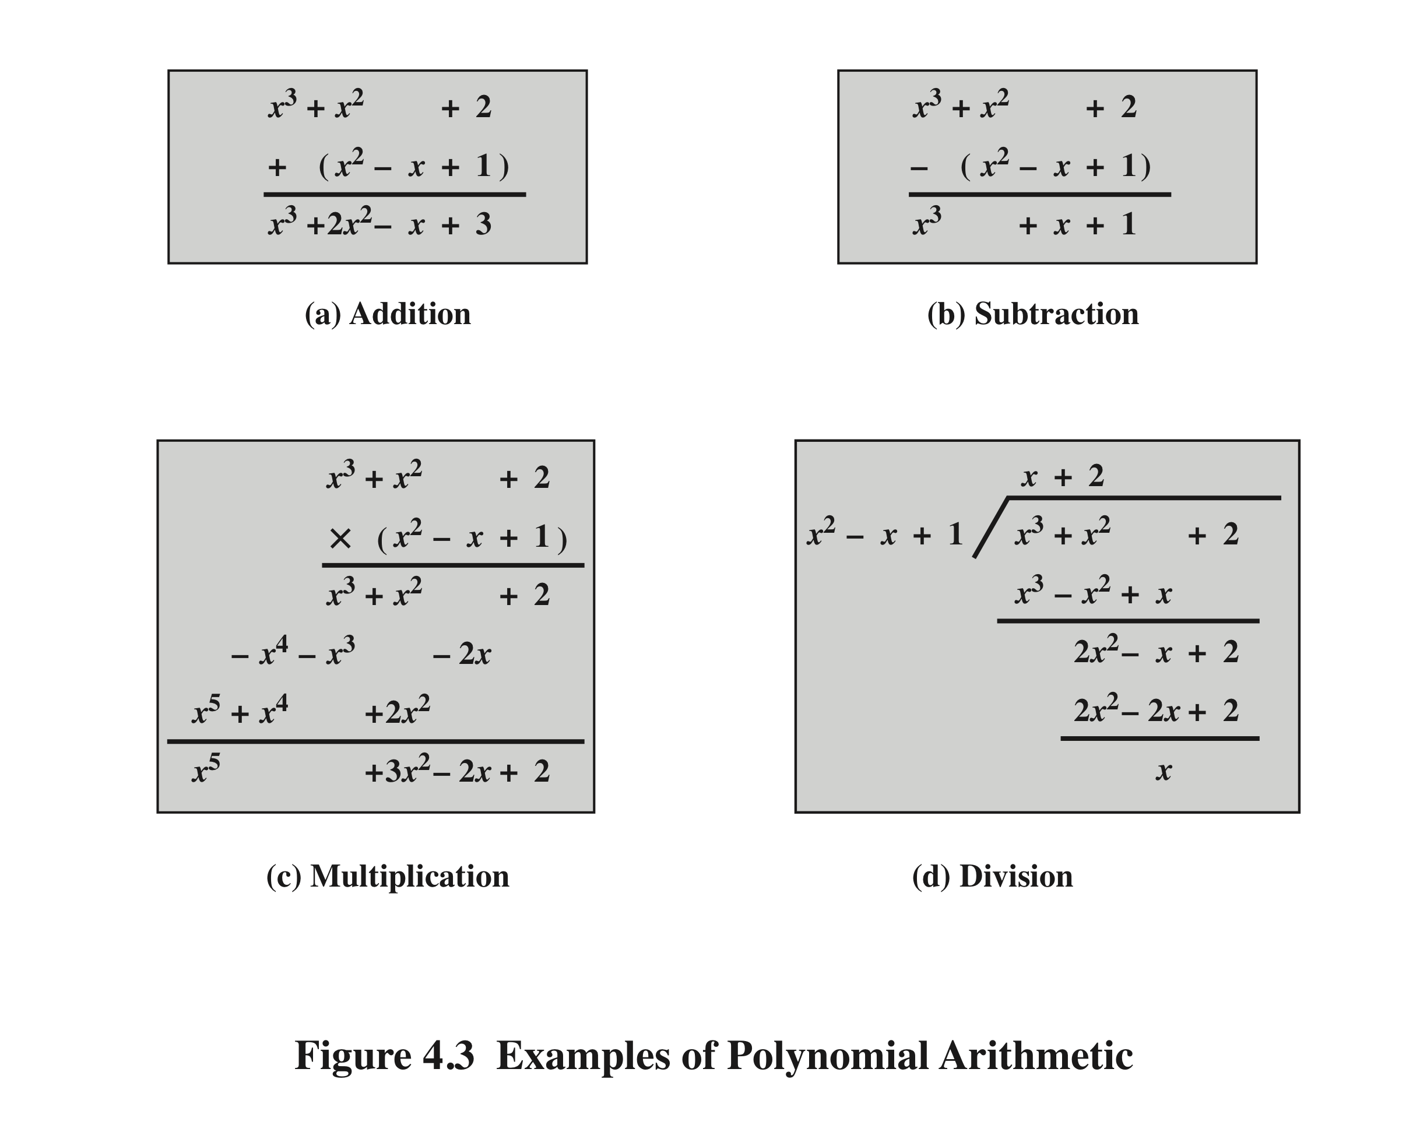
Notes:
Examples of Polynomial Arithmetic

Slide 26
Polynomial Arithmetic With Coefficients in Z_{p}
If each distinct polynomial is considered to be an element of the set, then that set is a ring
When polynomial arithmetic is performed on polynomials over a field, then division is possible
    Note: this does not mean that exact division is possible
    If we attempt to perform polynomial division over a coefficient set that is not a field, we find that division is not always defined
    Even if the coefficient set is a field, polynomial division is not necessarily exact
    With the understanding that remainders are allowed, we can say that polynomial division is possible if the coefficient set is a field
Notes:
Let us now consider polynomials in which the coefficients are elements of some
field F; we refer to this as a polynomial over the field F. In that case, it is easy to
show that the set of such polynomials is a ring, referred to as a polynomial ring .
That is, if we consider each distinct polynomial to be an element of the set, then
that set is a ring.
When polynomial arithmetic is performed on polynomials over a field, then
division is possible. Note that this does not mean that exact division is possible.
Let us clarify this distinction. Within a field, given two elements a and b , the
quotient a /b is also an element of the field. However, given a ring R that is not a
field, in general, division will result in both a quotient and a remainder; this is not
exact division.
Now, if we attempt to perform polynomial division over a coefficient set that
is not a field, we find that division is not always defined.
However, as we demonstrate presently, even if the coefficient set is a field,
polynomial division is not necessarily exact. In general, division will produce a quotient
and a remainder.
With the understanding that remainders are allowed, we can say that polynomial
division is possible if the coefficient set is a field.

Slide 27
Polynomial Division
We can write any polynomial in the form:
  f(x) = q(x) g(x) + r(x)
  r(x) can be interpreted as being a remainder
  So r(x) = f(x) mod g(x)
If there is no remainder we can say g(x) divides f(x)
  Written as g(x) | f(x)
  We can say that g(x) is a factor of f(x)
  Or g(x) is a divisor of f(x)
A polynomial f(x) over a field F is called irreducible if and only if f(x) cannot be expressed as a product of two polynomials, both over F, and both of degree lower than that of f(x)
  An irreducible polynomial is also called a prime polynomial
Notes:
Note that we can write any polynomial in the form of f(x) = q(x) g(x) + r(x), where division of f(x) by g(x) results in a quotient q(x) and remainder r(x). Can then extend the concept of divisors from the integer case, and show that the Euclidean algorithm can be extended to find the greatest common divisor of two polynomials whose coefficients are elements of a field.
Define an irreducible (or prime) polynomial as one with no divisors other than itself & 1. If compute polynomial arithmetic modulo an irreducible polynomial, this forms a finite field, and the GCD & Inverse algorithms can be adapted for it.

Slide 28
Example
E.g. 1
f(x) = x³ + x² + 2
g(x) = x² - x + 1
f(x)/g(x) produces a quotient of q(x) = x + 2 and a remainder r(x) = x.

Slide 29
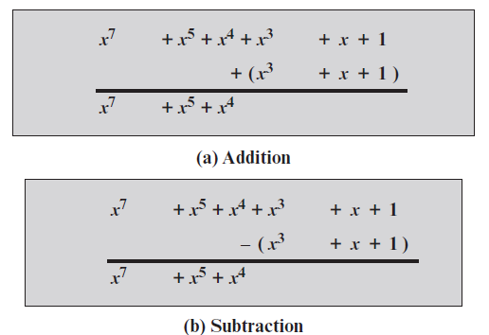
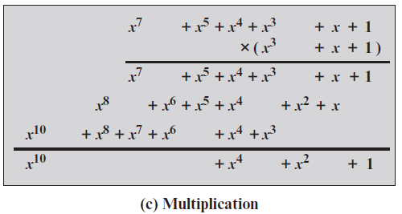
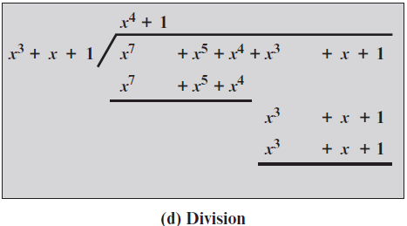
E.g.2
Polynomial Arithmetic
Over GF(2)
f(x) = (x7 + x5 + x4 + x3 + x + 1)
g(x) = (x3 + x + 1),
Note that g(x) f(x).
f(x) + g(x);
f(x) - g(x);
f(x) * g(x);
f(x)/g(x).
(Figure 4.4 can be found on page 110 in the textbook)
Notes:
Figure 4.4 shows an example of polynomial arithmetic over GF(2).

Slide 30
Polynomial GCD
The polynomial c(x) is said to be the greatest common divisor GCD of a(x) and b(x) if the following are true:
  c(x) divides both a(x) and b(x)
  Any divisor of a(x) and b(x) is a divisor of c(x)
An equivalent definition is:
  gcd[a(x), b(x)] is the polynomial of maximum degree that divides both a(x) and b(x)
The Euclidean algorithm can be extended to find the greatest common divisor of two polynomials whose coefficients are elements of a field
gcd[a(x), b(x)] = gcd[b(x), a(x) mod b(x)]
Notes:
We can extend the analogy between polynomial arithmetic over a field and integer
arithmetic by defining the greatest common divisor as follows. The polynomial c(x)
is said to be the greatest common divisor of a(x) and b(x) if the following are true.
1. c(x) divides both a(x) and b(x).
2. Any divisor of a(x) and b(x) is a divisor of c(x).
An equivalent definition is the following: gcd[a (x ), b (x )] is the polynomial of
maximum degree that divides both a (x ) and b (x ).
We can adapt the Euclidean algorithm to compute the greatest common
Divisor of two polynomials.

Slide 31
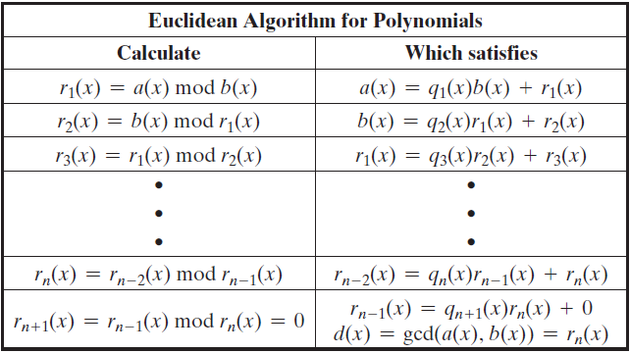
Euclidean Algorithm for Polynomials
gcd[a(x), b(x)] = gcd[b(x), a(x) mod b(x)]

Slide 32
Exercise
Calculate gcd[a(x), b(x)]
  a(x) = x⁶ + x⁵ + x⁴ + x³ + x² + x + 1
  b(x) = x⁴ + x² + x + 1
  = gcd(b(x), a(x)mod b(x))
  =gcd(x⁴ + x² + x + 1, (x⁶ + x⁵ + x⁴ + x³ + x² + x + 1) mod (x⁴ + x² + x + 1) )

Slide 33
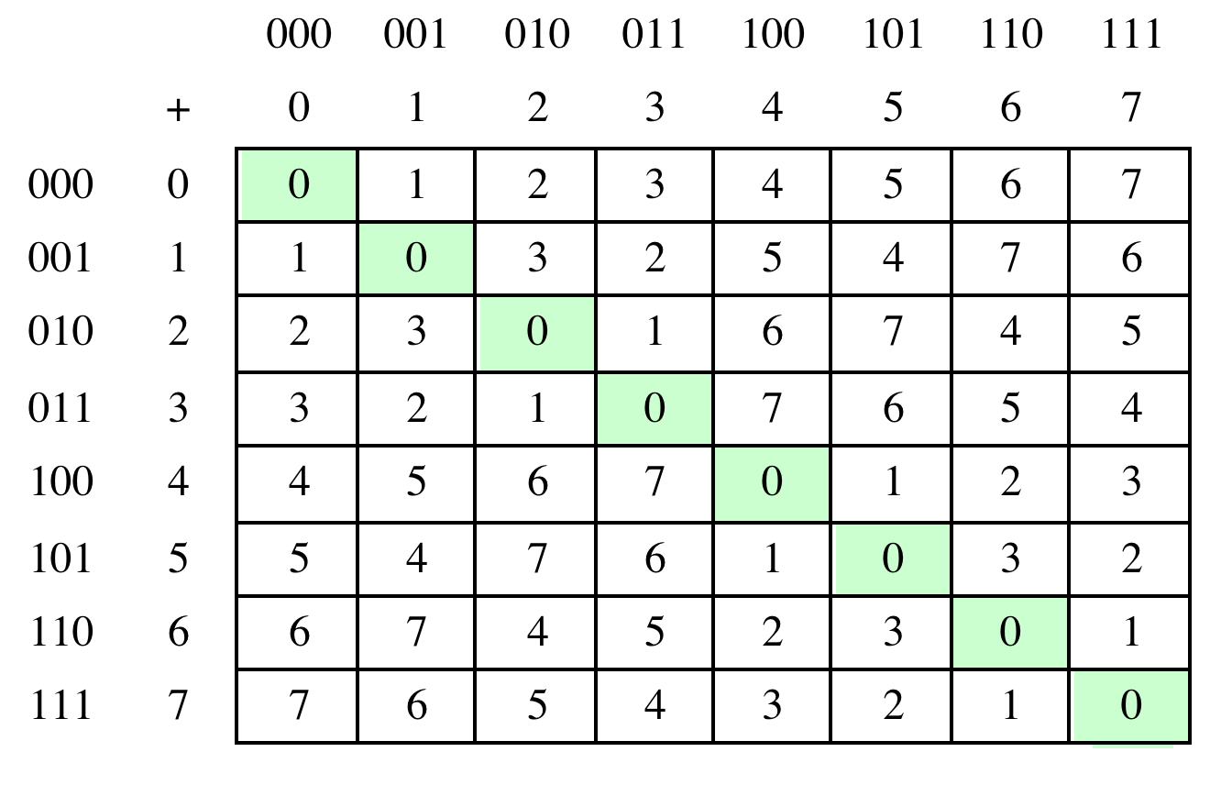
Table 4.6(a) Arithmetic in GF(2³)
(a) Addition
Notes:
Table 4.6 Arithmetic in GF(23)

Slide 34
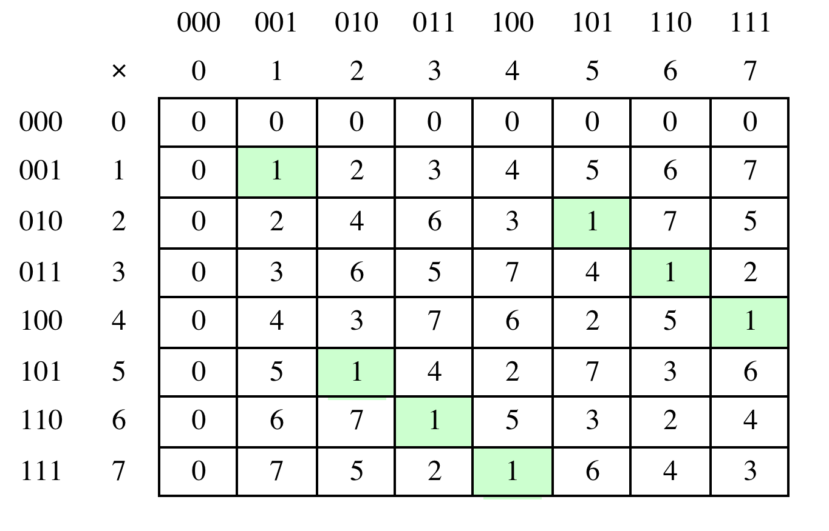
Table 4.6(b) Arithmetic in GF(2³)
(b) Multiplication
Notes:
Table 4.6 Arithmetic in GF(23)

Slide 35
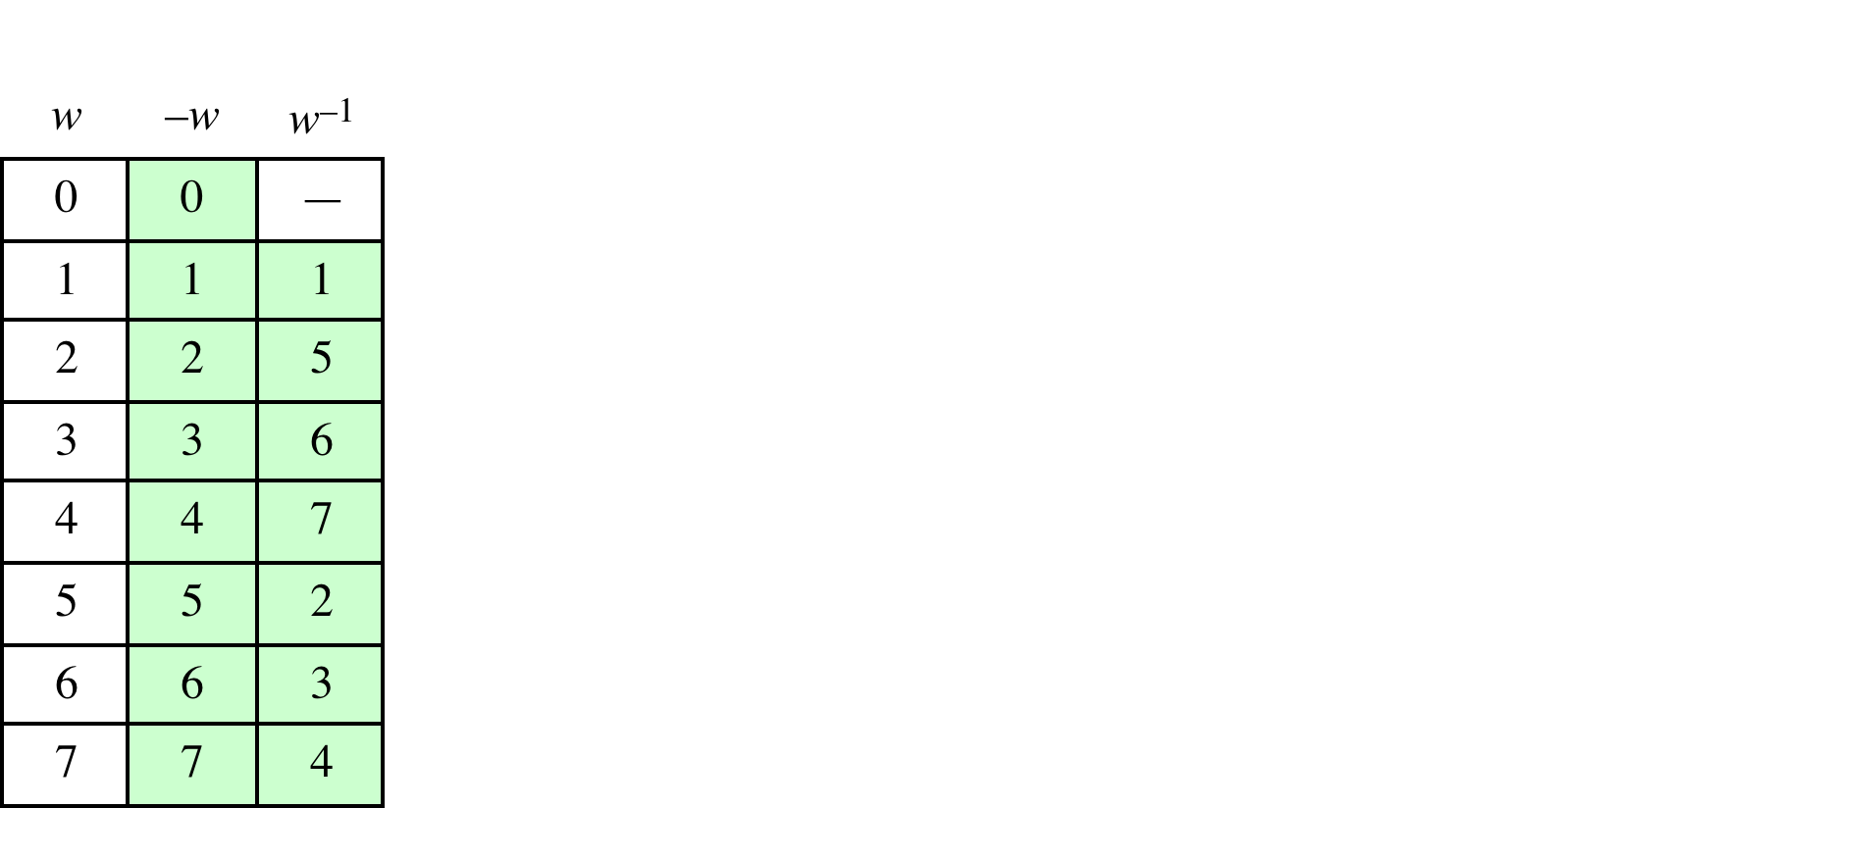
Table 4.6(c)
Arithmetic in GF(2³)
(c) Additive and multiplicative inverses
Notes:
Table 4.6 Arithmetic in GF(23)

Slide 36
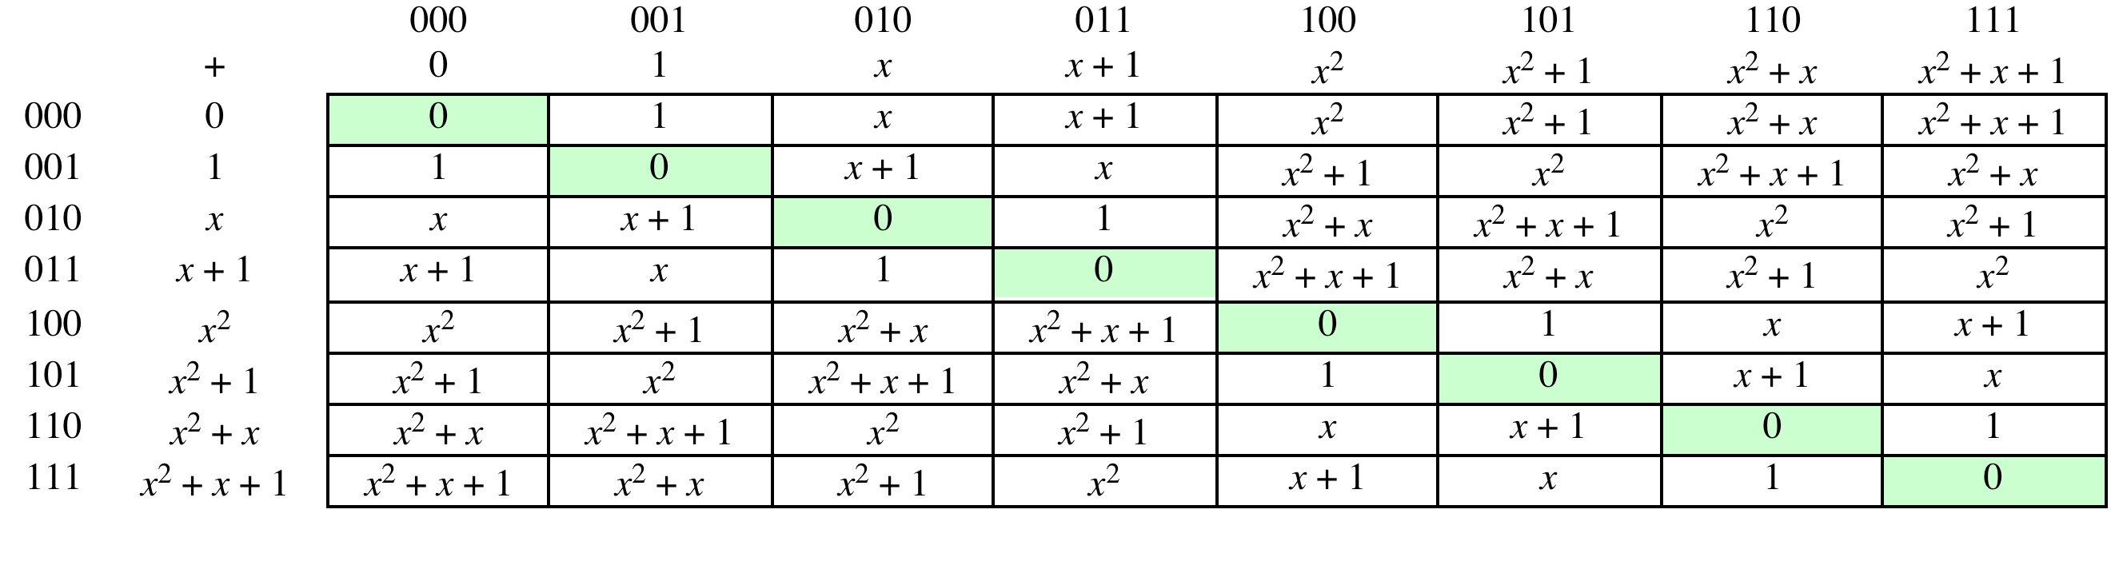
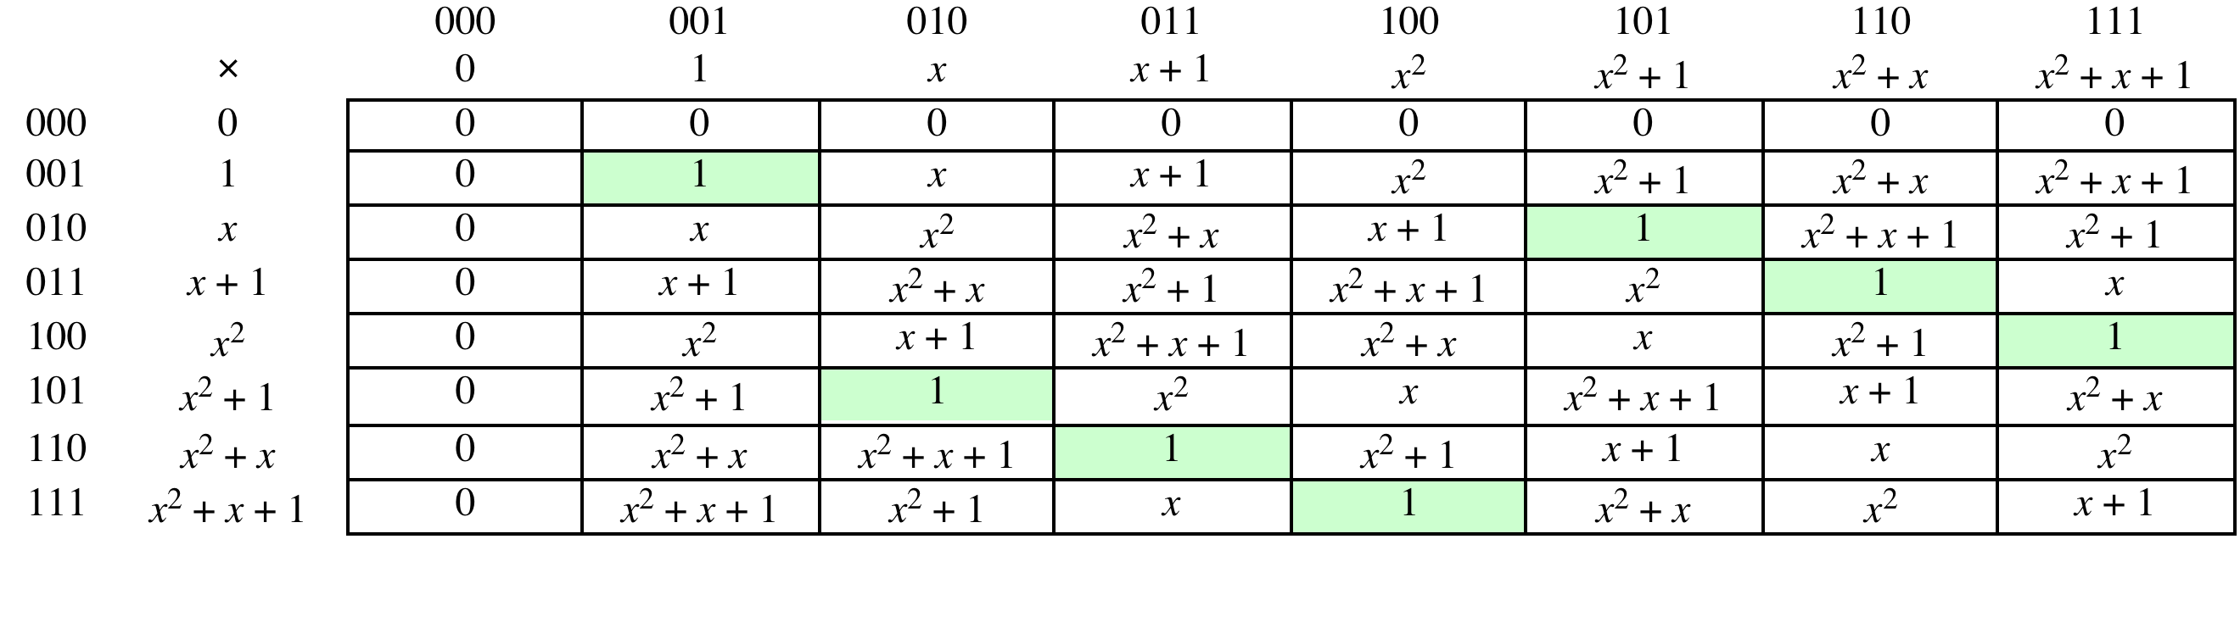
Table 4.7 Polynomial Arithmetic Modulo (x³ + x + 1)
(a) Addition
(b) Multiplication
(page 117 in textbook)
Notes:
Example shows addition & multiplication in GF(2³) modulo (x³+x+1)

Slide 37
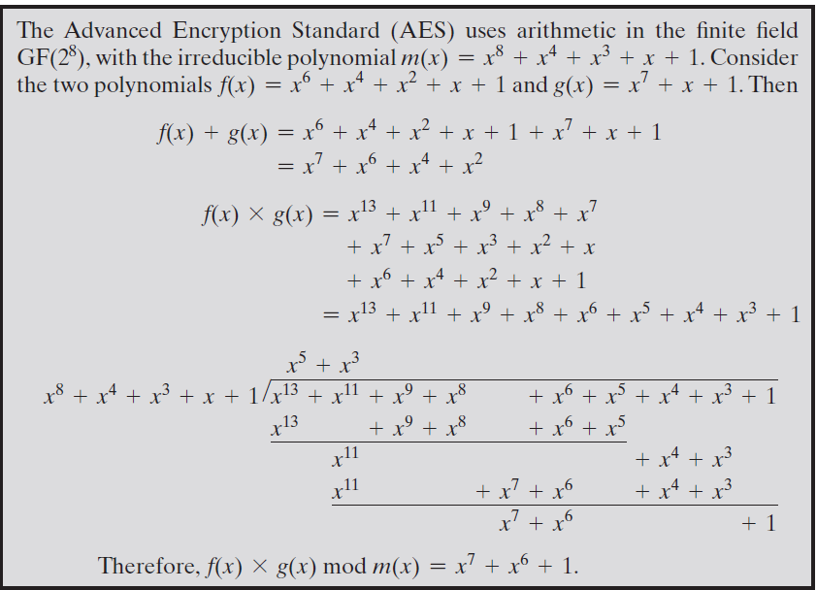

Slide 38
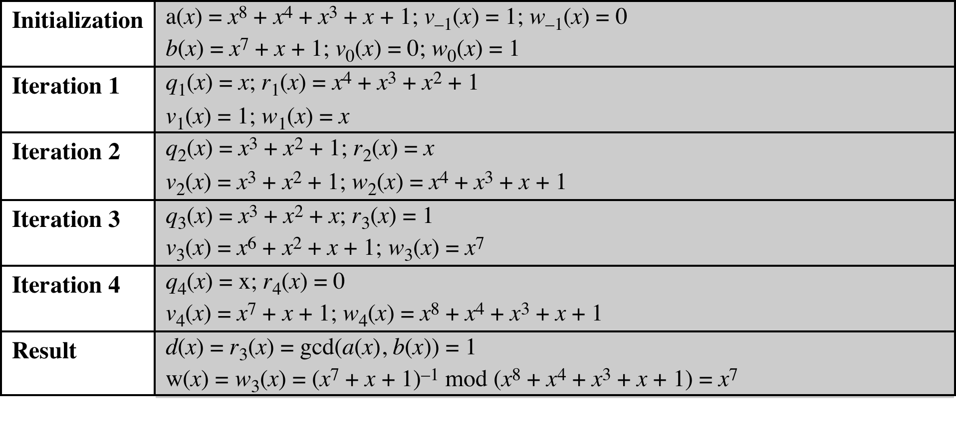
Table 4.8
Extended Euclid [(x⁸ + x⁴ + x³ + x + 1), (x⁷ + x + 1)]
(Table 4.8 can be found on page 118 in textbook)
Notes:
Table 4.8 Extended Euclid [(x8 + x4 + x3 + x + 1), (x7 + x + 1)]

Slide 39
Computational Considerations
Since coefficients are 0 or 1, they can represent any such polynomial as a bit string
Addition becomes XOR of these bit strings
Multiplication is shift and XOR
  cf long-hand multiplication
Modulo reduction is done by repeatedly substituting highest power with remainder of irreducible polynomial (also shift and XOR)
Notes:
A key motivation for using polynomial arithmetic in GF(2^{n}) is that the polynomials can be represented as a bit string, using all possible bit values, and the calculations only use simple common machine instructions - addition is just XOR, and multiplication is shifts & XOR’s. See text for additional discussion. The shortcut for polynomial reduction comes from the observation that if in GF(2^{n}) then irreducible poly g(x) has highest term x^{n} , and if compute x^{n} mod g(x) answer is g(x)- x^{n}

Slide 40
Using a Generator
A generator g of a finite field F of order q (contains q elements) is an element whose first q-1 powers generate all the nonzero elements of F
  The elements of F consist of 0, g⁰, g¹, . . . ., g^{q-2}
  Consider a field F defined by a polynomial f(x)
  An element b contained in F is called a root of the polynomial if f(b) = 0
  Finally, it can be shown that a root g of an irreducible polynomial is a generator of the finite field defined on that polynomial
Notes:
An equivalent technique for defining a finite field of the form GF(2^{n} ), using the
same irreducible polynomial, is sometimes more convenient. To begin, we need two
definitions: A generator g of a finite field F of order q (contains q elements) is an
element whose first q - 1 powers generate all the nonzero elements of F. That is, the
elements of F consist of 0, g⁰ , g¹ , c , g^{q-2} . Consider a field F defined by a polynomial
f (x ). An element b contained in F is called a root of the polynomial if f (b ) = 0.
Finally, it can be shown that a root g of an irreducible polynomial is a generator of the
finite field defined on that polynomial.

Slide 41
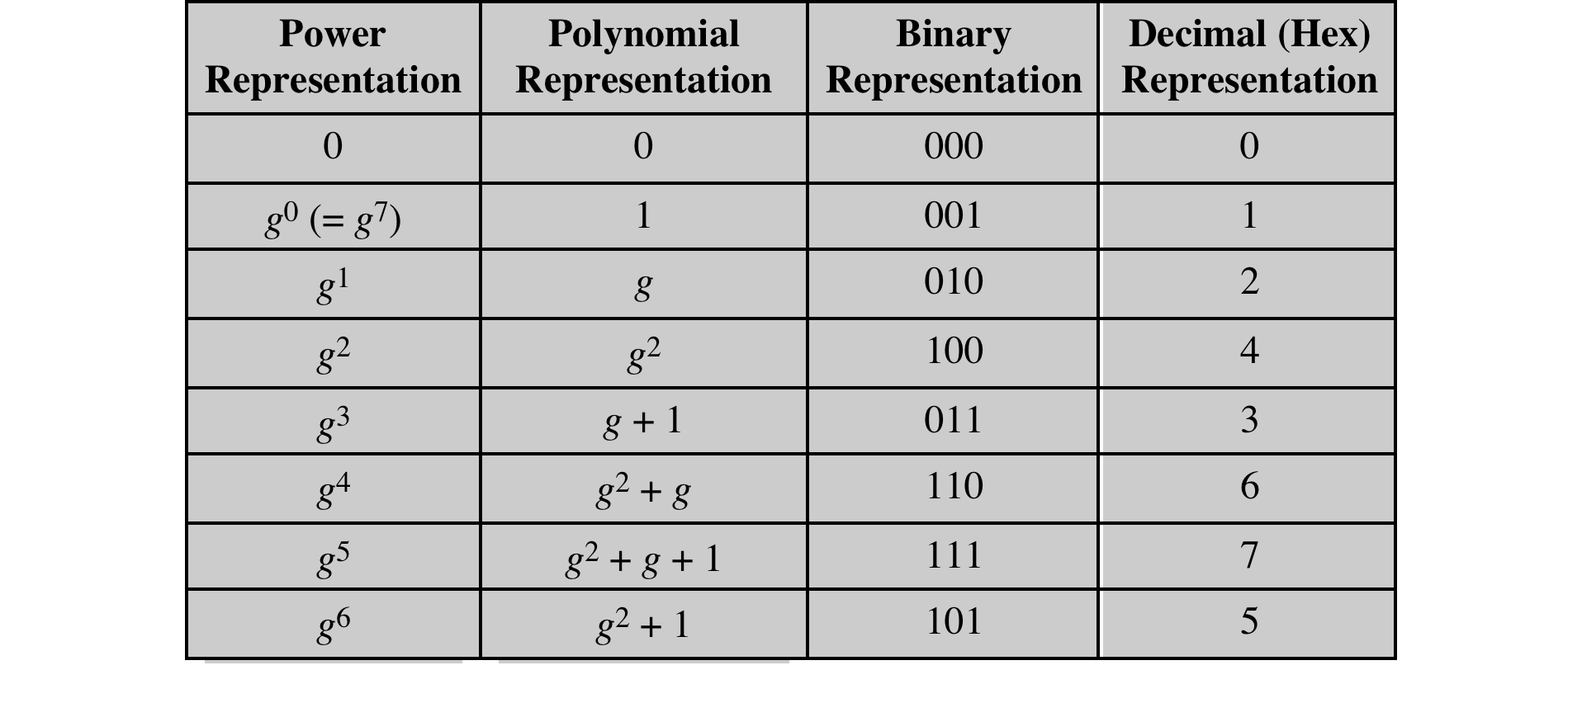
Table 4.9
Generator for GF(2³) using x³ + x + 1
Notes:
Table 4.9 Generator for GF(2³) using x³ + x + 1

Slide 42
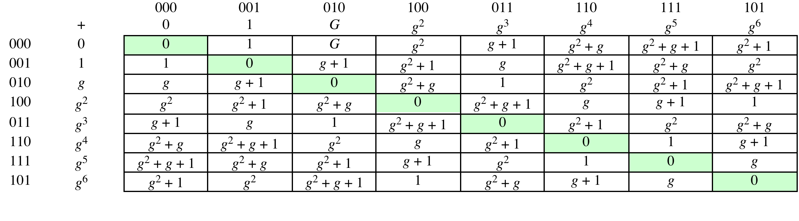
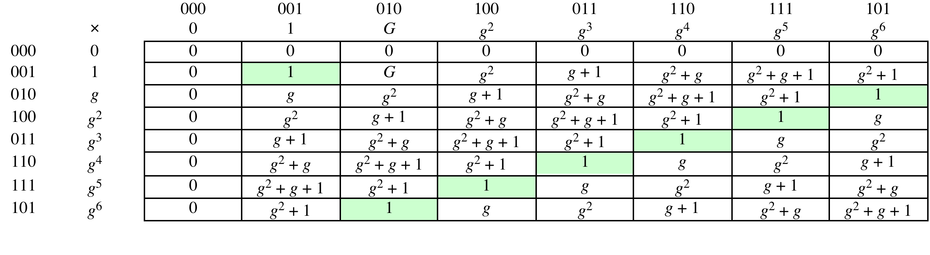
Table 4.10
GF(2³) Arithmetic Using Generator for the Polynomial (x³ + x + 1)
(a) Addition
(b) Multiplication
(page 123 in textbook)
Notes:
Table 4.10 GF(2³) Arithmetic Using Generator for the Polynomial (x³ + x + 1)

Slide 43
Summary
Divisibility and the division algorithm
The Euclidean algorithm
Modular arithmetic
Groups, rings, and fields
Finite fields of the form GF(p)
Polynomial arithmetic
Finite fields of the form GF(2^{n})
Notes:
Chapter 4 summary.

